Slide 1

CSE 3002 - Programming in Java Course Type: LP Credits: 3

Slide 2
Unit-3
Java Exception Handling
Java Exceptions, Java Exception Handling, Java try...catch, Java throw and throws, Java catch Multiple Exceptions, Java Annotations Types
Multithreading
Introduction, Thread Creations, Thread Life Cycle, Life Cycle Methods, Java Synchronization methods, User-defined packages.

Slide 3
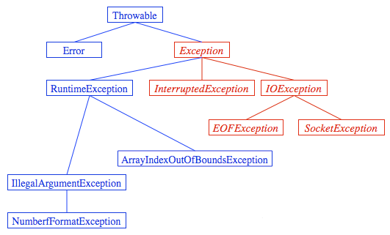
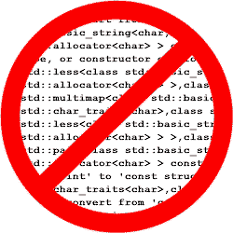

What do you understand

Slide 4
What You Will Learn
Use
try, throw, catch
to
watch for indicate exceptions handle
How to process exceptions and failures.

Slide 5
Java Exception Handling
The Exception Handling in Java is one of the powerful mechanism to handle the runtime errors so that the normal flow of the application can be maintained.
In this tutorial, we will learn about Java exceptions, it's types, and the difference between checked and unchecked exceptions.
What is Exception in Java?
Dictionary Meaning: Exception is an abnormal condition.
In Java, an exception is an event that disrupts the normal flow of the program. It is an object which is thrown at runtime.
What is Exception Handling?
Exception Handling is a mechanism to handle runtime errors such as ClassNotFoundException, IOException, SQLException, RemoteException, etc.

Slide 6
Java Exception Handling
Advantage of Exception Handling
The core advantage of exception handling is to maintain the normal flow of the application. An exception normally disrupts the normal flow of the application; that is why we need to handle exceptions. Let's consider a scenario:
statement 1;
statement 2;
Statement 3;//exception occurs
statement 4;
statement 5;
Suppose there are 5 statements in a Java program and an exception occurs at statement 3; the rest of the code will not be executed, i.e., statements 4 to 5 will not be executed.
However, when we perform exception handling, the rest of the statements will be executed. That is why we use exception handling in Java.

Slide 7
Java Exception Handling
Types of Java Exceptions
There are mainly two types of exceptions: checked and unchecked. An error is considered as the unchecked exception. However, according to Oracle, there are three types of exceptions namely:
Checked Exception
Unchecked Exception
Error

Slide 8
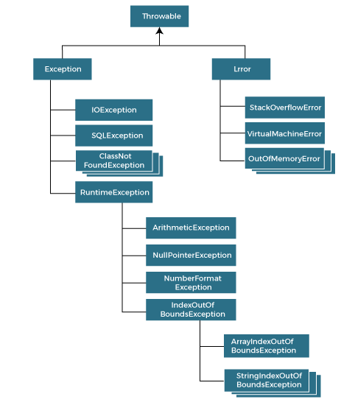
Java Exception Handling
Hierarchy of Java Exception classes
The java.lang.Throwable class is the root class of Java Exception hierarchy inherited by two subclasses: Exception and Error. The hierarchy of Java Exception classes is given below:

Slide 9
Java Exception Handling
Difference between Checked and Unchecked Exceptions
1) Checked Exception
The classes that directly inherit the Throwable class except RuntimeException and Error are known as checked exceptions.
For example, IOException, SQLException, etc. Checked exceptions are checked at compile-time.
2) Unchecked Exception
The classes that inherit the RuntimeException are known as unchecked exceptions. For example, ArithmeticException, NullPointerException, ArrayIndexOutOfBoundsException, etc. Unchecked exceptions are not checked at compile-time, but they are checked at runtime.
3) Error
Error is irrecoverable. Some example of errors are OutOfMemoryError, VirtualMachineError, AssertionError etc.

Slide 10
Java Exception Handling
An exception is an abnormal condition that arises in a code sequence at run time.
In other words, an exception is a run-time error.
Exception-Handling Fundamentals
Java exception is an object that describes an exceptional (that is, error) condition that has occurred in a piece of code.
When an exceptional condition arises, an object representing that exception is created and thrown in the method that caused the error.
Java exception handling is managed via five keywords:
try, catch, throw, throws and finally.
Program statements that you want to monitor for exceptions are contained within a try block.

Slide 11
Java Exception Handling
Java Exception Keywords
Java provides five keywords that are used to handle the exception. The following table describes each.
Keyword | Description
try | The "try" keyword is used to specify a block where we should place an exception code. It means we can't use try block alone. The try block must be followed by either catch or finally.
catch | The "catch" block is used to handle the exception. It must be preceded by try block which means we can't use catch block alone. It can be followed by finally block later.
finally | The "finally" block is used to execute the necessary code of the program. It is executed whether an exception is handled or not.
throw | The "throw" keyword is used to throw an exception.
throws | The "throws" keyword is used to declare exceptions. It specifies that there may occur an exception in the method. It doesn't throw an exception. It is always used with method signature.

Slide 12
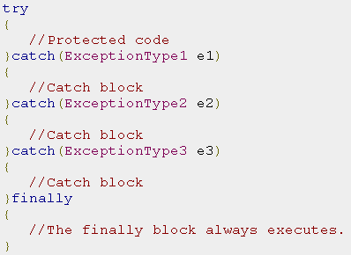
Java Exception Handling
This is the general form of an exception-handling block:

Slide 13
Java Exception Handling
Exception Types
Throwable is at the top of the exception class hierarchy.
Immediately below Throwable are two subclasses that partition exceptions into two distinct branches.
One branch is headed by Exception.
This class is used for exceptional conditions that user programs should catch.
This is also the class that you will subclass to create your own custom exception types.
There is an important subclass of Exception, called Runtime Exception.

Slide 14
Java Exception Handling
Uncaught Exceptions
The expression that intentionally causes a divide-by-zero error.
class Exc0 {
public static void main(String args[]) {
int d = 0;
int a = 42 / d;
}
}
When the Java run-time system detects the attempt to divide by zero
it constructs a new exception object and then throws this exception.

Slide 15
Java Exception Handling
Java Exception Handling Example
Let's see an example of Java Exception Handling in which we are using a try-catch statement to handle the exception.
JavaExceptionExample.java
public class JavaExceptionExample{
public static void main(String args[]){
try{
//code that may raise exception
int data=100/0;
}catch(ArithmeticException e){System.out.println(e);}
//rest code of the program
System.out.println("rest of the code...");
}
}
Output:
Exception in thread main java.lang.ArithmeticException:/ by zero rest of the code...

Slide 16
Common Scenarios of Java Exceptions
4) A scenario where ArrayIndexOutOfBoundsException occurs
When an array exceeds to it's size, the ArrayIndexOutOfBoundsException occurs. there may be other reasons to occur ArrayIndexOutOfBoundsException. Consider the following statements.
int a[]=new int[5];
a[10]=50; //ArrayIndexOutOfBoundsException

Slide 17
Common Scenarios of Java Exceptions
There are given some scenarios where unchecked exceptions may occur. They are as follows:
1) A scenario where ArithmeticException occurs
If we divide any number by zero, there occurs an ArithmeticException.
int a=50/0;//ArithmeticException
2) A scenario where NullPointerException occurs
If we have a null value in any variable, performing any operation on the variable throws a NullPointerException.
String s=null;
System.out.println(s.length());//NullPointerException
3) A scenario where NumberFormatException occurs
If the formatting of any variable or number is mismatched, it may result into NumberFormatException. Suppose we have a string variable that has characters; converting this variable into digit will cause NumberFormatException.
String s="abc";
int i=Integer.parseInt(s);//NumberFormatException

Slide 18
Using try and catch
class Exc2 {
public static void main(String args[]) {
int d, a;
try { // monitor a block of code.
d = 0;
a = 42 / d;
System.out.println("This will not be printed.");
} catch (ArithmeticException e)
{ // catch divide-by-zero error
System.out.println("Division by zero.");
}
System.out.println("After catch statement.");
}
}

Slide 19
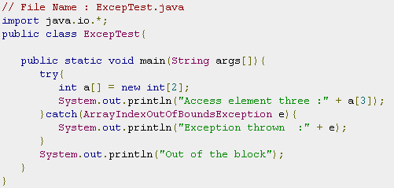
Using try and catch
Output:
Exception thrown :java.lang.ArrayIndexOutOfBoundsException: 3
Out of the block

Slide 20
Multiple catch Clauses
Here is the output generated by running it both ways:
C:\>java MultiCatch
a = 0
Divide by 0: java.lang.ArithmeticException: / by zero
After try/catch blocks.
C:\>java MultiCatch TestArg
a = 1
Array index oob: java.lang.ArrayIndexOutOfBoundsException
After try/catch blocks.

Slide 21
Multiple catch Clauses
class MultiCatch {
public static void main(String args[]) {
try {
int a = args.length;
System.out.println("a = " + a);
int b = 42 / a;
int c[] = { 1 };
c[42] = 99;
} catch(ArithmeticException e) {
System.out.println("Divide by 0: " + e);
} catch(ArrayIndexOutOfBoundsException e) {
System.out.println("Array index oob: " + e);
}
System.out.println("After try/catch blocks.");
}
}

Slide 22
throw
output:
Caught inside demoproc.
Recaught: java.lang.NullPointerException: demo
class ThrowDemo {
static void demoproc() {
try {
throw new NullPointerException("demo");
} catch(NullPointerException e)
{
System.out.println("Caught inside demoproc.");
throw e; // rethrow the exception
}
}
public static void main(String args[]) {
try { demoproc();
} catch(NullPointerException e)
{ System.out.println("Recaught: " + e); }
} }

Slide 23
throw
This program gets two chances to deal with the same error.
First, main( ) sets up an exception context and then calls demoproc( ).
The demoproc( ) method then sets up another exception-handling context and immediately throws a new instance of NullPointerException, which is caught on the next line.
The exception is then re-thrown.

Slide 24
throws
A throws clause lists the types of exceptions that a method might throw.
All other exceptions that a method can throw must be declared in the throws clause.
If they are not, a compile-time error will result.
Type method-name(parameter-list) throws exception-list
{ // body of method }
Here, exception-list is a comma-separated list of the exceptions that a method can throw.

Slide 25
throws
// This program contains an error and will not compile.
class ThrowsDemo {
static void throwOne() {
System.out.println("Inside throwOne.");
throw new IllegalAccessException("demo");
}
public static void main(String args[])
{ throwOne(); }
}

Slide 26
throws
// This is now correct
class ThrowsDemo {
static void throwOne() throws IllegalAccessException
{
System.out.println("Inside throwOne.");
throw new IllegalAccessException("demo");
}
public static void main(String args[]) {
try {
throwOne();
}
catch (IllegalAccessException e) {
System.out.println("Caught " + e);
}
}
}
Output:
inside throwOne
caught java.lang.IllegalAccessException: demo

Slide 27
Finally
finally creates a block of code that will be executed after a try/catch block has completed and before the code following the try/catch block.
The finally block will execute whether or not an exception is thrown.
finally
{
System.out.println("procA's finally");
}

Slide 28
Java’s Built-in Exceptions
Exception | Meaning
ArithmeticException | Arithmetic error, such as divide-by-zero.
ArrayIndexOutOfBoundsException | Array index is out-of-bounds.
ArrayStoreException | Assignment to an array element of an incompatible type
ClassCastException | Invalid cast.
IllegalArgumentException | Illegal argument used to invoke a method.
IllegalMonitorStateException | Illegal monitor operation, eg: waiting on an unlocked thread.
IllegalStateException | Environment or application is in incorrect state
IllegalThreadStateException | Requested operation not compatible with current thread state
IndexOutOfBoundsException | Some type of index is out-of-bounds
NegativeArraySizeException | Array created with a negative size
NullPointerException | Invalid use of a null reference
UnsupportedOperationException | An unsupported operation was encountered

Slide 29
More details
https://www.javatpoint.com/exception-handling-in-java

Slide 30
Creating Your Own Exception Subclasses
To create your own exception types to handle situations specific to your applications.
Define a subclass of Exception, subclasses don’t need to actually implement anything.
The Exception class does not define any methods of its own.
It inherit t.hose methods provided by Throwable
Throwable fillInStackTrace( )
Throwable getCause( )
String getLocalizedMessage( )
String getMessage( )
StackTraceElement[ ] getStackTrace( )
Throwable initCause(Throwable causeExc)
void printStackTrace( )
void printStackTrace(PrintStream stream)
void printStackTrace(PrintWriter stream)
void setStackTrace(StackTraceElement elements[ ])
String toString( )

Slide 31
Mind map
Multiple catch
Uncaught Exceptions
Nested try Statements
Exception Types
Chained Exceptions
throw, throws, finally
Exception Handling
Java’s Built-in Exceptions
Creating Own Exception Subclasses

